Slide 1
Module 1
Climate Change, Impacts, and
Effects on the Business
Country, Date, Presenter
PPT with exemplary information for Rwanda. Please adapt to your local context.

Slide 2
Objective
The objectives of this module are to:
  review relevant background and concepts of climate change,
  learn about past and expected climate trends in Rwanda, and
  learn about past and projected impacts of climate change in Rwanda and its implications for businesses,

Slide 3
Outline / Agenda
Climate trends worldwide
Climate change phenomena, impacts and adaptation
Climate Change in Rwanda
Building awareness of SMEs on climate change and its impacts on business

Slide 4
I. Climate Trends Worldwide

Slide 5
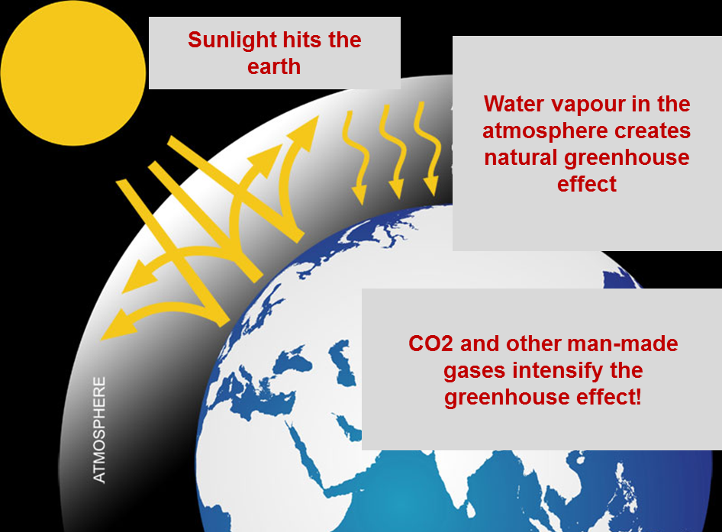
II. Climate Change Phenomena, Impacts & Adaptation
– The Climate is changing because of man-made emissions
Climate change = significant change in the climate system over time
More heat is trapped
in the atmosphere,
setting in motion a
range of dynamics
Source: US department of Energy Efficiency and Renewable Energy

Slide 6
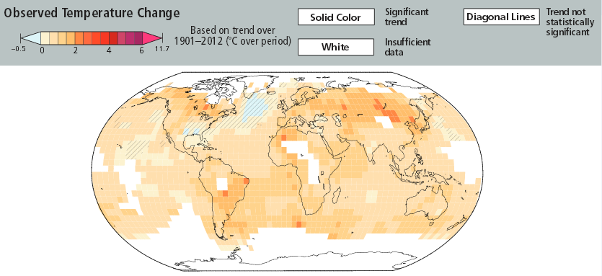
I. Climate Trends Worldwide
– Past temperature changes 2000– 2009
Reference period: 1901-2012
In many areas of the world, temperature has increased considerably (~2°C) in the last decade
Important to focus on long-term trends, not yearly variations! Temperature increase is undeniable!
Source: IPCC 2014

Slide 7
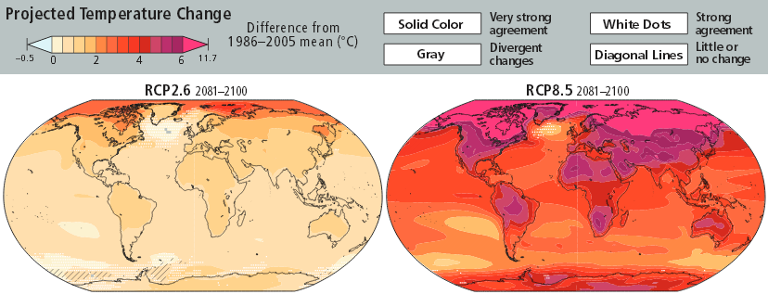

I. Climate Trends Worldwide
– Future projections 2081-2100
Low—emissions, mitigation scenario
High—emissions scenario
Temperature is predicted to continue to rise,
even with increasing mitigation efforts!
Source: IPCC 2014

Slide 8
I. Climate Trends Worldwide
– Changes in climate affect weather, ecosystem and people
Changes | +1⁰C | +2⁰C | +3⁰C | +4⁰C | +5⁰C
Weather
Ecosystem
People
 | 2020-2030 | 2050 | 2080
More intense storms, floods, forest fires, extreme drought, heat waves
Ecosystem damaged, harvest yields low
Many more species face extinction
Weather/food and water shortages force migration of millions; risk of conflicts increases
Source: IPCC Scenario A1B

Slide 9
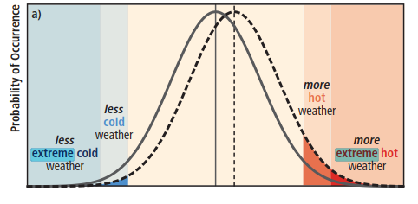
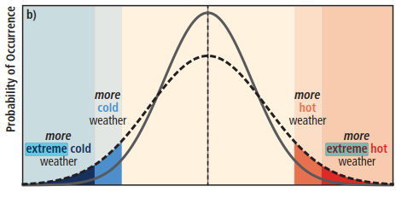
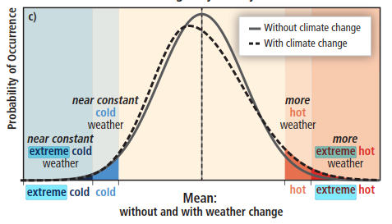
I. Climate Trends Worldwide
– Changes in the extremes can be linked to:
Changes in the mean
(to the right, warmer climate):
more extreme hot weather, less extreme cold weather
Changes in the variability
(without changes in the mean):
more extreme hot weather & more extreme cold weather
Changes in the symmetry:
more extreme hot weather & constant extreme cold weather
…or a combination of these.
Source: IPCC 2010
Source: IPCC Scenario A1B

Slide 10
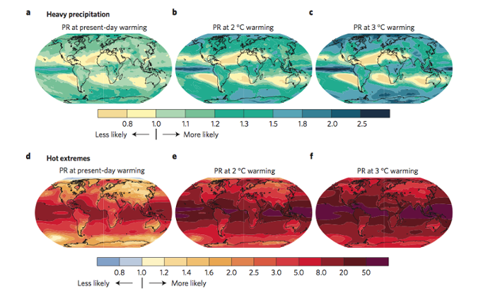
I. Climate Trends Worldwide
– Slight changes in the mean, sharp increases in extremes
-Relatively- small changes in the mean temperature (2°C-3°C),
can generate sharp changes in probability of the extremes (hot extremes 3% Vs. 50% more likely)
Source: Fischer & Knutti 2015

Slide 11
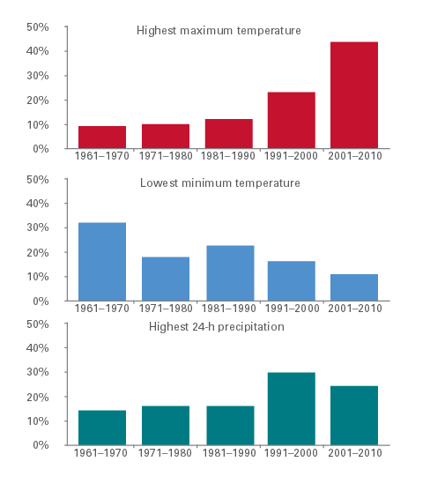
I. Climate Trends Worldwide
– Development of the climate extremes over the last decade
2001-2010 was the second wettest since 1901
2001-2010 witnessed the highest number of daily maximum temperatures since 1961
2010 tied 2005 as the warmest years on record globally
In 2010, 19 countries saw new national high-temperature records
In 2010, most countries had above-normal precipitation
Daily maximum and minimum temperature and 24-hour total precipitation (1961-2010)
Source: UNEP, 2013; C2ES, 2011.

Slide 12
II. Climate Change Phenomena,
Impacts & Adaptation

Slide 13

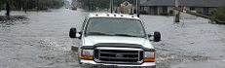
II. Climate Change Phenomena, Impacts & Adaptation
– Two faces of climate change: gradual climate change and extreme weather events
Gradual climate change
Extreme weather
Kelly Sikkema CC0 1.00
Chuck Simmons CC BY 2.0
Changes in the mean state of the climate or its variability over longer periods of time
Direct link to greenhouse effect – warming of atmosphere leads to changes in the general trends of temperature, rainfall, etc.
Unusually strong weather events such as floods or extreme droughts, cold or storms
Indirect link to greenhouse effect: changes in the mean have consequences for the intensity of extremes
Not “natural disasters” → man-made aspect!
Influence

Slide 14

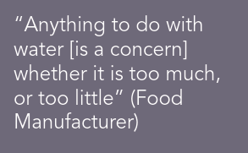

II. Climate Change Phenomena, Impacts & Adaptation
– Extreme weather events, climate change and the private sector – global events & challenges
Source: Defra / Social Change UK 2012

Slide 15
II. Climate Change Phenomena, Impacts & Adaptation
– Businesses expect impacts of climate change to matter greatly
Increasing cost for input materials
Other risks mentioned include transportation risks, deterioration of water quality, decreased agricultural productivity, risk of flood, drought, impacts on coastal resources, food security, threats to ecosystem and biodiversity
Souce: UN Global Compact 2011

Slide 16




II. Climate Change Phenomena, Impacts & Adaptation
– The business logic behind adaptation
$$
$
€
Ensuring BUSINESS CONTINUITY by
MANAGING THE RISKS of climate change
CLIMATE CHANGE ADAPTATION
Creating COMPETITIVE ADVANTAGE through positive side-effects of adaptation measures, (e.g. by increasing
water use efficiency)
Creating BUSINESS OPPORTUNITIES from climate change through
NEW PRODUCTS & SERVICES

Slide 17
II. Climate Change Phenomena, Impacts & Adaptation
– Putting adaptation in context
Climate change mitigation
Carbon footprinting and energy efficiency
Climate change adaptation
Managing CC risks and opportunities for survival and growth
Environmental management
Compliance,
resource efficiency,
responsibility, eco-labels, EMS
Overlap: some activities in one field support and contribute to the other

Slide 18
III. Climate Change in Rwanda

Slide 19
III. Climate Change in Rwanda
– Relevance for businesses in Rwanda
Climatic changes and the increase in extreme weather events are already having an impact on Rwandan businesses
  Kigali‘s old industrial park is often getting flooded, damaging goods and assets, forcing companies to suspend operations
  Heavy rains and landslides have damaged pivotal roads in different parts of the country in recent years, disrupting transport of production inputs to businesses, e.g. labels for bottles, and of products to markets, e.g. to Kigali
  Heat waves are affecting productivity of employees in different sectors, from construction to manufacturing
  Rainy seasons are shifting and becoming less predictable – this has impacted agricultural yields and triggered reductions in output in some agro-processing companies
Notes:
Add specific information on climate change impacts that have occured in your country / region

Slide 20
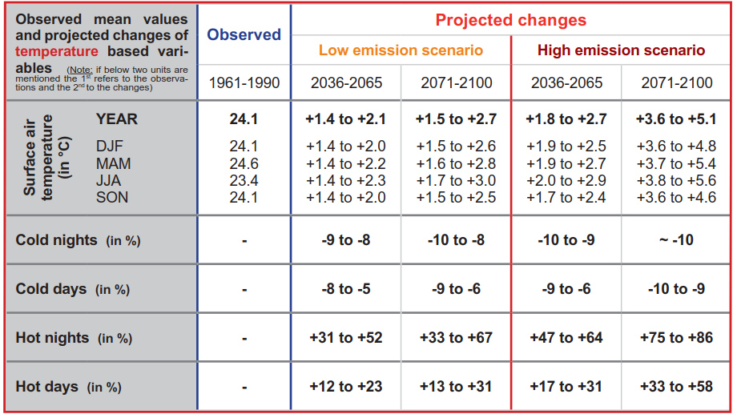
III. Climate Change in Rwanda
– Past and future changes in Rwanda: Temperature
Source: CSC 2011

Slide 21
III. Understanding climate change in Rwanda
– Past and future changes in Rwanda: Temperature
Past
Annual average temperature has risen since 1971 by about 1.4°C
Increasing trend of +0.35°C per decade between 1971 and 2010
Future
Average temperature expected to increase up to 2.5°C by 2050 and ca. 4°C by 2080
Impacts
Lower quality of soil, more difficult harvests, lower yields
Increasing health risks due to high temperatures (e.g. spread of diseases)
Relevance for businesses
Heat waves are affecting productivity of employees in different sectors, from construction to manufacturing
Source: GIZ & adelphi 2015

Slide 22
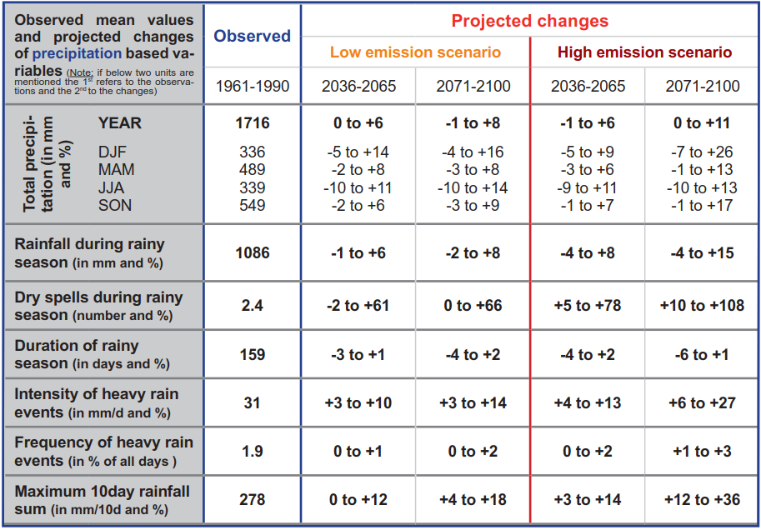
III. Climate Change in Rwanda
– Past and future changes in Rwanda: Precipitation
Source: CSC 2011

Slide 23
III. Understanding past and projected impacts in Rwanda
– Past and future changes in Rwanda: Precipitation
Past
No clear trend in precipitation changes, but unusually heavy rains in the North and more severe droughts in the East and South in the last 20 years
Rainy seasons are shifting and becoming less predictable
Future
Estimated that large parts of Rwanda will experience increase in average precipitation with more intense rainfall during shorter rainy seasons
Impacts
Difficulty to project seasons and rainfall yields
Water availability lower / cost of water rises
Damages of pivotal roads
Relevance for businesses
Kigali‘s old industrial park is often getting flooded, damaging goods and assets, forcing companies to suspend operations
Heavy rains and landslides have damaged pivotal roads disrupting transport
Changes in rainy seasons impact agricultural yields and trigger reductions in output in some agro-processing companies

Slide 24
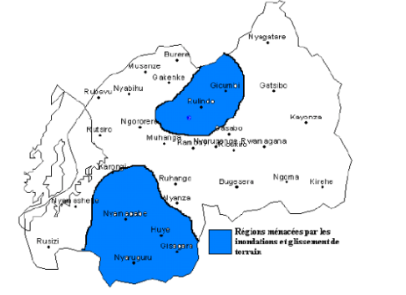
III. Climate Change in Rwanda
– Past and future changes in Rwanda: Drought, floods and erosion
Regions at risks of floods and landslides
Source: Netherlands Commission for Environmental Assessment 2015

Slide 25
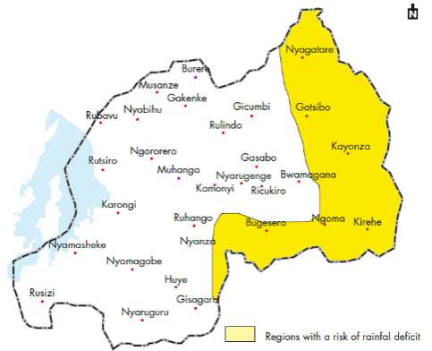
III. Climate Change in Rwanda
– Past and future changes in Rwanda: Droughts
Regions at risks of drought
Source: Netherlands Commission for Environmental Assessment 2015

Slide 26
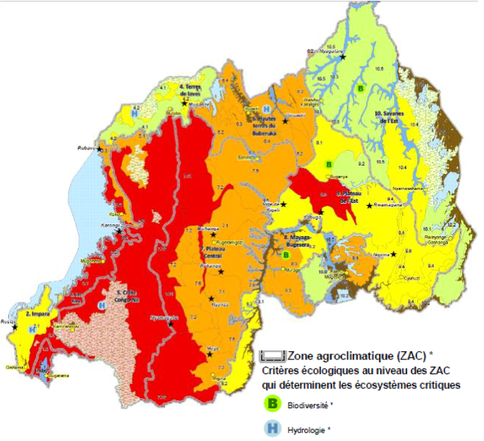
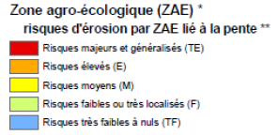
III. Climate Change in Rwanda
– Past and future changes in Rwanda: Erosion
Regions at risks of erosion
Source: Netherlands Commission for Environmental Assessment 2015

Slide 27
III. Understanding past and projected impacts in Rwanda
– Past and future changes in Rwanda: Extreme weather events
Past
No extreme weather event can be linked directly to climate change, but evidence is mounting that change in means also affects change in extremes;
Floods and landslides triggered by heavy rains destroyed 3,934 homes in 2013
Future
South and Southeast are likely to experience more frequent droughts
Impacts
High risks result for infrastructure and people
Relevance for businesses
Higher risk for businesses installations and buildings as well as within their value chain (transport).
Source: GIZ & adelphi 2015

Slide 28
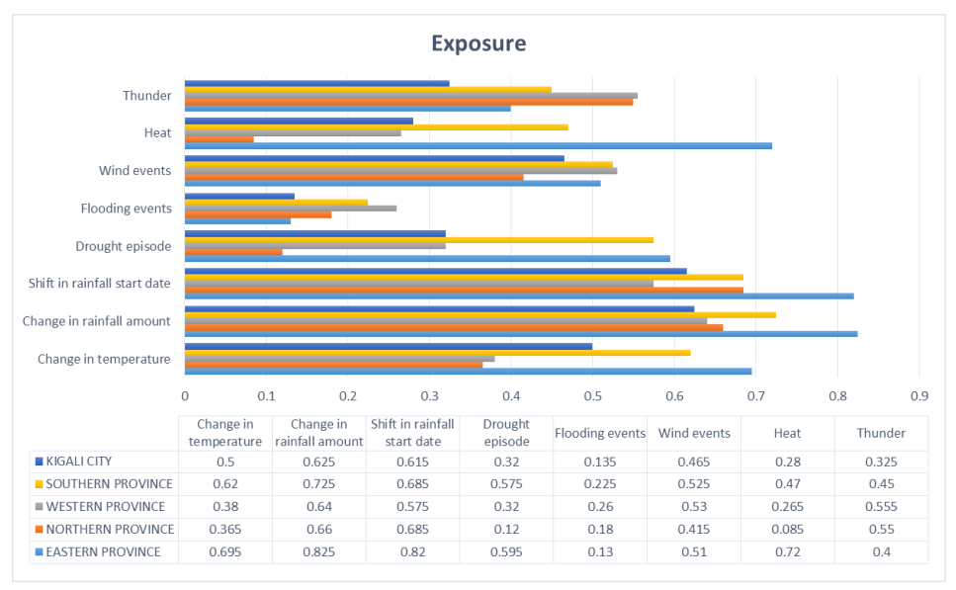
III. Climate Change in Rwanda
– Past and future changes in Rwanda: Exposure to climate change
Source: REMA 2015

Slide 29
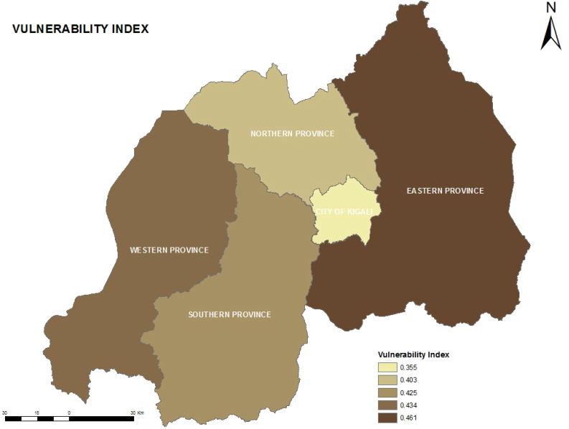
III. Climate Change in Rwanda
– Past and future changes in Rwanda: Vulnerability
Source: REMA 2015

Slide 30

Discussion
– Climate Change Phenomena, Impacts & Adaptation
What climate change phenomena have you experienced?
Which ones do you perceive as generally most relevant?
Which regions are most threatened by climate change?
Do you see positive aspects of climate change for the country?

Slide 31
IV. Building awareness on climate change impacts on businesses

Slide 32
IV. Climate change impacts on businesses
– Climate phenomena, impacts, negative effects on the business and opportunities
Climate change phenomenon
Climate change impact(s) on ...
Company
natural system
Negative effects on the business
human system
Opportunity

Slide 33
IV. Climate change impacts on businesses
– Climate phenomena
Warmer and/or fewer cold days and nights
Warmer and/or more frequent hot days and nights
Increase in frequency and/or duration of heat waves
Increase in frequency and /or intensity of heavy rain events
Increase in intensity and/or duration of droughts
Increase in intense tropical cyclone activity
Increase in sea level rise
Climate change phenomenon
Source: IPCC 2014

Slide 34
IV. Climate change impacts on businesses
– Climate impacts
Climate impacts
often occur in impact chains
Agricultural production loss
Wetland loss
Sea level rise
Migration
Land loss
Damages to infrastructure
Source: PIK

Slide 35
IV. Climate change impacts on businesses
– Negative effect on the business or opportunity
Agricultural production loss
Higher prices for raw materials
Negative effects on the business
Migration
Cheaper labour available
Opportunity
Damages to infrastructure
Destroyed machinery
Negative effects on the business

Slide 36





IV. Climate change impacts on businesses
– Direct and indirect effects
Indirect effects
affect a company by way of an impact on another system outside of the company’s control
Direct effects
damage buildings and plant processes straightaway
Company
Other systems & stakeholders

Slide 37
IV. Climate change impacts on businesses
– Examples of direct and indirect effects on business
Direct effects
damage buildings and plant processes straightaway
Indirect effects
affect a company by way of an impact on another system outside of the company’s control
  Rooftops are damaged during heavy storms
  Raw materials in stock become spoiled by fungi after heavy rains
  Machinery overheats during periods of extreme heat
  Workers’ health deteriorates during heat waves
  Reduced availability of energy / water from the grid
  Delayed deliveries from suppliers whose premises had been flooded
  Stricter regulation concerning energy efficiency and water use
  Reduced demand for specific products due to changed weather conditions

Slide 38







IV. Climate change impacts on businesses
– Businesses have seven impact areas of climate change
Infrastructure and processes | Building / Location
 | Processes
 | Logistic and stock
Stakeholders | Employees and community
 | Government and regulation
Market and finance | Market
 | Finance

Slide 39
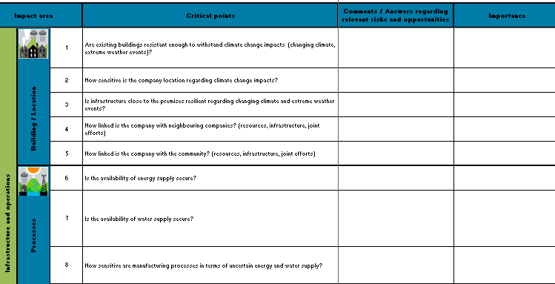
IV. Climate change impacts on businesses
– Assessment Grid

Slide 40
IV. Climate Change Phenomena, Impacts & Adaptation
– Activities in the private sector
Some companies in Rwanda are adapting to climate change
  Companies have installed storage racks that allow storing materials above the ground preventing them to be damaged in case of floods.
  Activities like the installation of diesel generators are wide spread and can protect from interruptions of the grid after weather-related disasters but come at considerable financial and environmental costs
  A beverage company has started its own 300 hectares maize farm with an efficient irrigation system reducing their dependence on rain
  Smaller farms have formed a saving initiative to a save funds for procuring a rain-fed water tank that will be shared among them
  Tea companies are using tea plants that are more robust against weather extremes than older varieties
Notes:
Add examplary adaptation measures by companies that have been implemented in your country

Slide 41
Discussion
– Climate Change Phenomena, Impacts & Adaptation
Which business sectors are most affected by climate change?
In which of the impact areas do you expect the largest potential damages?
Do you know of any adaptation measures being implemented by companies in the country?

Slide 42

Thank you for your attention!
Company
Trainer 1
Telephone number
E-Mail address
Homepage
Company
Trainer 2
Telephone number
E-Mail address
Homepage
Knowledge partner

Slide 43
Sources
CSC, GIZ, Wageningenur, & BMUB, 2011 : Climate Fact Sheet Rwanda, extract from Climate Report 2011. Available at: http://www.climate-service-center.de/imperia/md/content/csc/kongo/fact_sheet_climate_rwanda.pdf
C2ES, 2011: Extreme weather and Climate Change. Available at: http://www.c2es.org/publications/extreme-weather-and-climate-change
Defra / Social Change UK 2012: Adapting to climate change in the food industry. Available at: http://randd.defra.gov.uk/Document.aspx?Document=10016_DEFRA_report_FINAL_WEB.pdf
Fischer & Knutti 2014: Anthropogenic contribution to global occurrence of heavy-precipitation and high-temperature extremes. Available at: http://www.nature.com/nclimate/journal/v5/n6/full/nclimate2617.html
GIZ & adelphi 2015: Baseline Study on Climate Change Impacts on the Private Sector in Rwanda. Available at: https://www.adelphi.de/sites/default/files/mediathek/bilder/en/publications/application/pdf/cca_private_sector_country_baseline_study_outline_rwanda_1.pdf
IPCC 2010: Managing the Risks of Extreme Events and Disasters to Advance climate Change Adaptation. Available at: https://www.ipcc.ch/pdf/special-reports/srex/SREX_Full_Report.pdf
IPCC 2013: Summary for Policymakers. Available at: http://www.climatechange2013.org/images/report/WG1AR5_SPM_FINAL.pdf
IPCC 2014: Climate Change 2014. Impacts, Adaptation and Vulnerability. Summary for Policymakers. Available at: https://ipcc-wg2.gov/AR5/images/uploads/IPCC_WG2AR5_SPM_Approved.pdf
NAPA-Rwanda, 2006: National Adaptation Programmes of Action to Climate Change. Available at: http://unfccc.int/resource/docs/napa/rwa01e.pdf
Netherlands Commission for Environmental Assessment 2015 : Climate Change Profile RWANDA. Available at http://api.commissiemer.nl/docs/os/i71/i7152/climate_change_profile_rwanda.pdf
PIK, n.d.: Impact chains. Available at: http://www.pik-potsdam.de/~wrobel/ci_2/ic/ic.html
REMA 2015: Baseline Climate Change Vulnerability Index for Rwanda. Available at: http://www.climdev-africa.org/sites/default/files/DocumentAttachments/Baseline%20climate%20change%20vulnerability%20index%20for%20Rwanda.pdf
UNEP 2013: Report Shows Unprecedented Climate Extremes over Last Decade – Available at: http://www.unep.org/newscentre/default.aspx?DocumentID=2723&ArticleID=9561#sthash.J03FUPTt.dpuf
UN Global Compact 2011: Adapting for a Green Economy: Companies, Communities and Climate Change. A Caring for Climate Report. Available at: https://www.unglobalcompact.org/docs/issues_doc/Environment/climate/C4C_Report_Adapting_for_Green_Economy.pdf

